Slide 1

Open Broadcaster Software
Studio
Presentation by Wyatt Zacharias
2021
Except where otherwise noted this work is licensed under the Creative Commons Attribution-ShareAlike 4.0 International License. To view a copy of this license, visit http://creativecommons.org/licenses/by-sa/4.0/.

Slide 2
Introduction
OBS is a real-time video streaming and recording solution.
Provides live capture and encoding from multiple sources.
Available in compiled packages for Windows, macOS, and Linux.
Released under GNU GPL 2.0 license.

Slide 3
History
Initially created by Hugh “Jim” Bailey in 2012
After 2012 OBS quickly gained multiple contributors.
In 2014 a full re-write of OBS is started, dubbed “OBS Multiplatform” with the goal of multi-platform support and a more powerful API.
In 2016 the original OBS software is deprecated as “OBS Classic” and OBS Multiplatform becomes the primary version as “OBS Studio”.

Slide 4
Streaming Platforms
Youtube and Twitch the most popular public streaming platforms.
Include features such as live chat and real-time transcoding to different bitrates.
Most platforms still using the RTMP protocol.
HLS and DASH protocols starting to gain support.
RTMP endpoints typically use a unique endpoint ID as their only form of authentication.

Slide 5
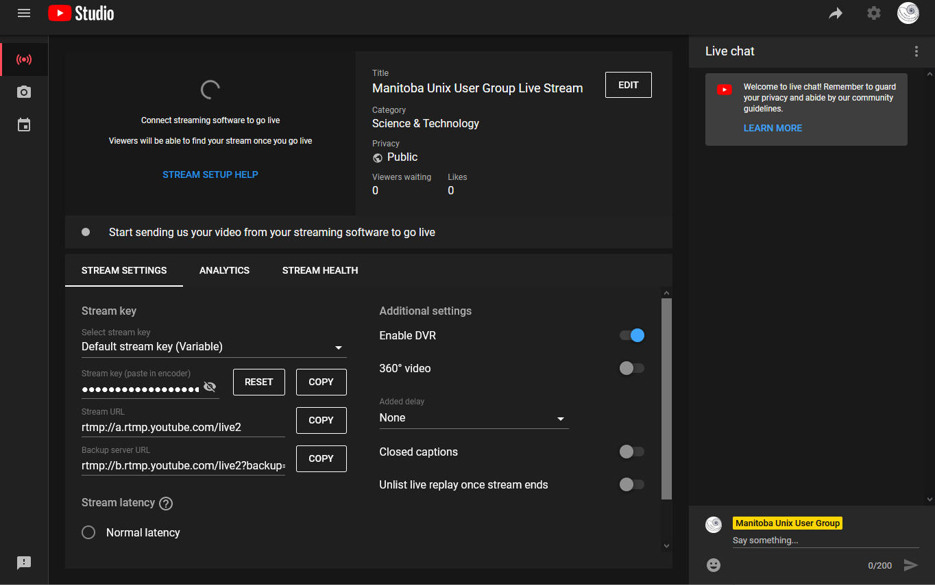
Youtube Live Dashboard

Slide 6
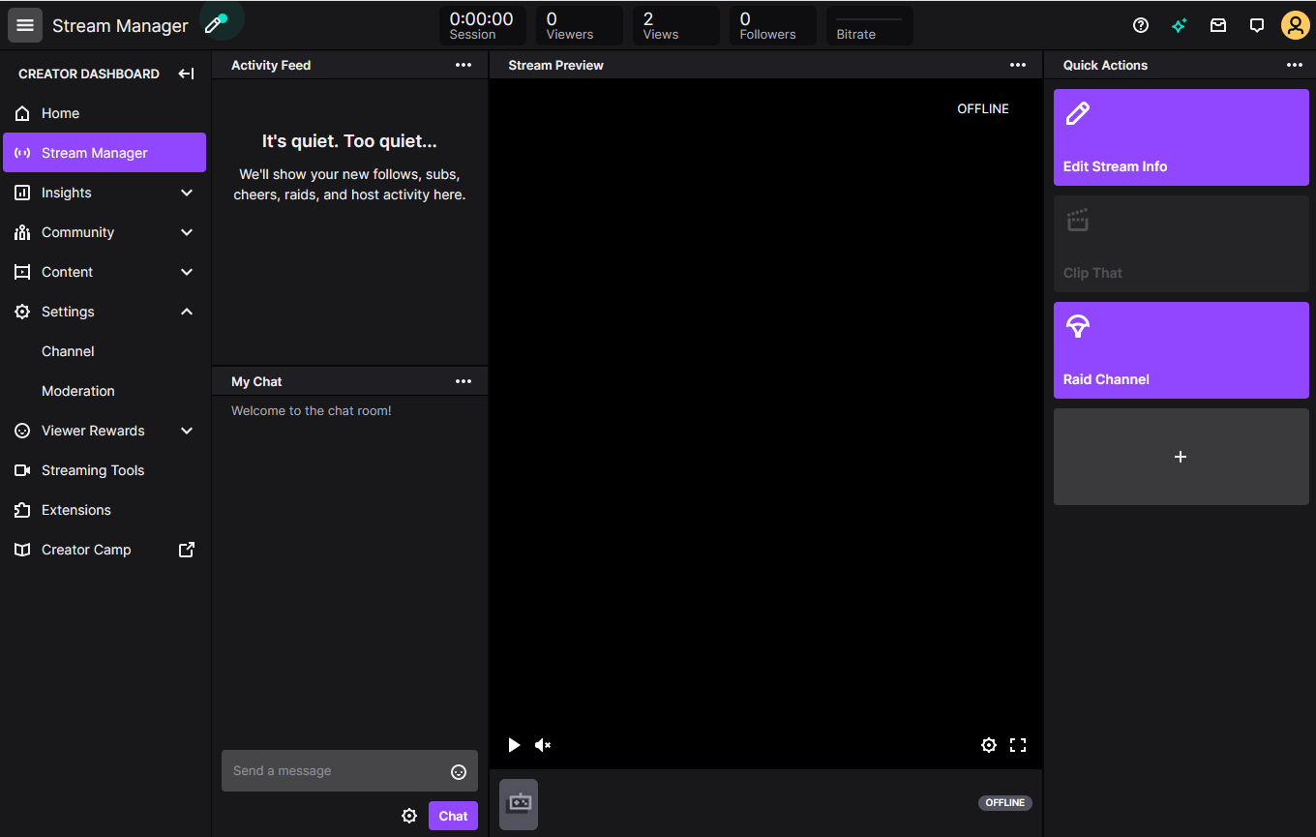
Twitch Live Dashboard

Slide 7
Hardware
Capture cards available with one or more inputs using HDMI or HD-SDI.
Capture cards typically only support standard broadcast formats.
Audio interfaces support professional quality microphones using XLR inputs and phantom power.
Modern mirrorless cameras and camcorders capable of clean output produce excellent image quality at 1080p or greater.
Custom peripherals such as the Elgato Stream Deck provide custom macro keys for custom functionality.

Slide 8
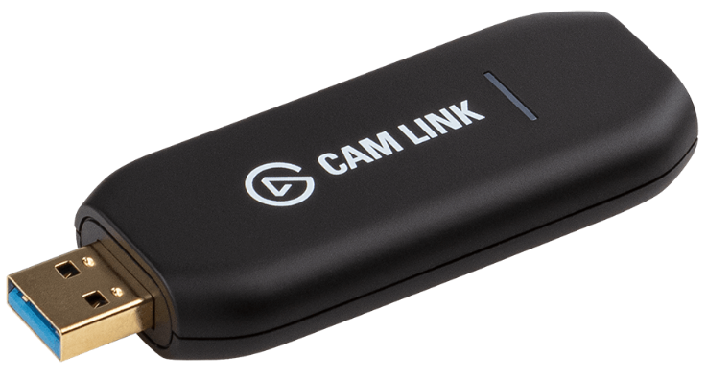
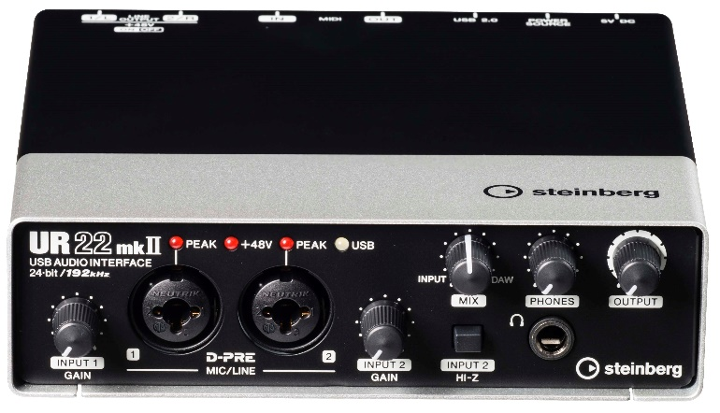
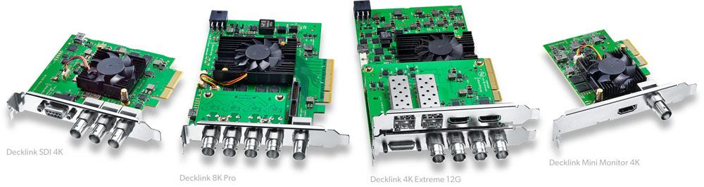
Cam Link image Copyright Elgato
UR22mkII image Copyright Steinberg
DeckLink image Copyright Blackmagicdesign

Slide 9
Encoders
Live H.264 video encoding can be very resource intensive.
Software encoding performed entirely with the CPU, works on any platform.
Hardware encoding utilizes dedicated H.264 chipsets and greatly reduces CPU utilization.
nVidia H.264 hardware encoding available from GTX9xx series onwards.
Intel QuickSync H.264 hardware encoding available from Sandy Bridge onwards.

Slide 10
Web Conference Integration
Conference apps such as Jitsi, Zoom, etc, expect to handle encoding and hardware configuration themselves.
In order to integrate with these apps, OBS developed a “virtual webcam” device which appears to other apps as a standard webcam.
Audio is separate and directly accessed by conference apps.
Conference apps use variable resolution and frame rates to achieve ultra low latency. This greatly reduces achievable audio & video quality.

Slide 11
Glossary
H.264 – Standard codec used for video encoding
Bitrate – The amount of data per second of an encoded stream. Typically Mb/s
Encoder – A piece of hardware or software used to encode raw video into a given codec.
RTMP – Real Time Messaging Protocol
HLS – HTTP Live Streaming
DASH – Dynamic Adaptive Streaming over HTTP

